Slide 1

Youtube downloader
Easy way to download yt videos

Slide 2
ABSTRACT
Youtube has more than 2.6 billion active users and around 800 million youtube videos on the platform as of 2022. In short there is a lot of content.
While browsing you may have wanted to download a certain video. Like you others might also want but youtube doesn't have download video feature. So we decided to build a platform where user will just paste URL of the video that user wants to download. he will get to download not only video but audio as well.
In this project we have used HTML, CSS and JAVASCRIPT to create youtube downloader website.

Slide 3
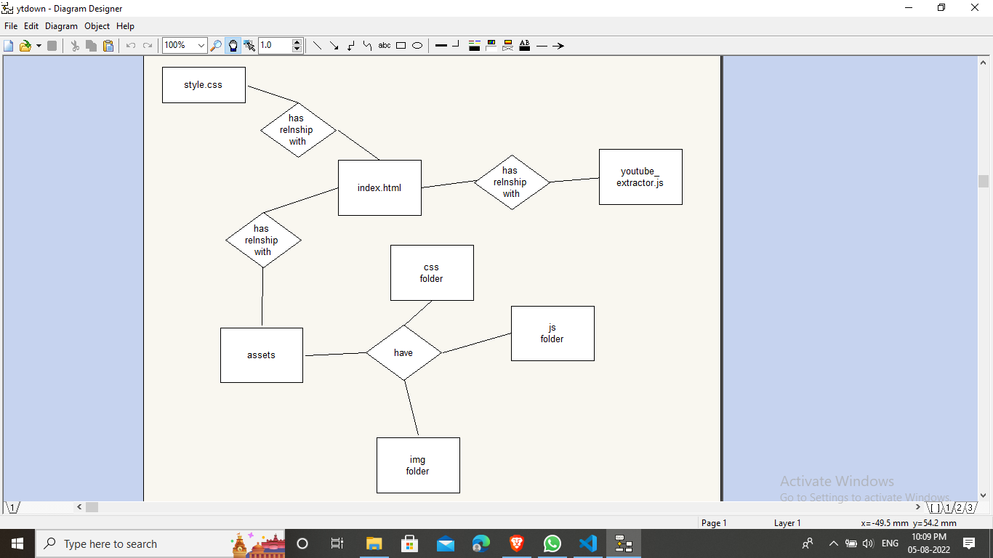
ER DIAGRAM

Slide 4
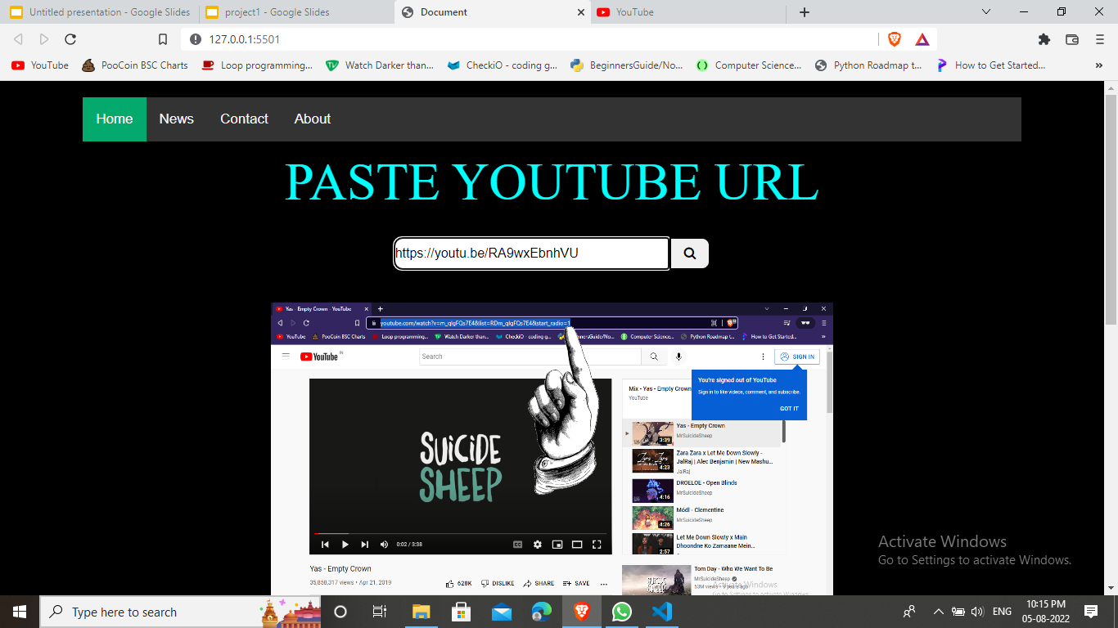
Front page

Slide 5
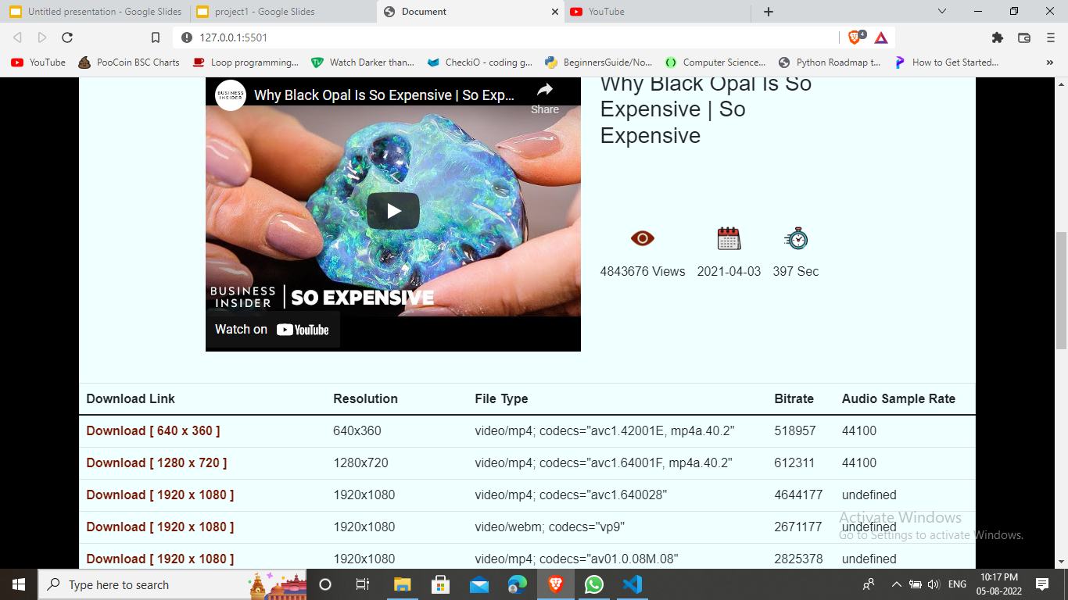
response

Slide 6
Live demo link
https://its-prat.github.io/ytdl/
credits
https://github.com/awesome-yasin/Media-Downloader/blob/02df4382c1ef02de6a76f35a5a7a81e153e7a69b/Youtube%20Downloader%20(V2)/youtube_extractor.js

Slide 7
Future plans
To add facebook video downloader
To add instagram video downloader
And so on……

